Slide 1
WK Multi-Label Text Classification
- Machine Learning and Deep Learning Techniques
BIA 667- Deep Learning & Application
Group6 Students
Amogh
Chirag
Saman
Sandeep Rao

Slide 2


Topics to be Discussed
Business Objective
Problem Definition
Data Collection & Analysis
Modelling Approach
Model Interpretation
Conclusion
Group 6| Text Classification using Deep Learning

Slide 3
Business Objective
Hackathon conducted by DataSolve with aims to provide Students an Opportunity
Connecting students to Wolters Kluwer executives with ideas on data science
Text Classification problem to classify the rules and Regulation change against right industry
Easy to manage the amendments if changes are classified correctly
Avoid regularity Violations if amendments are done on time
Dataset consists regulatory changes for Banking, Insurance and Financial services providers
Consists of regulation name , summary text of regulation change
Classify the regulation change and tag against the Industry based on their importance
Important and can even automate their assignment to the right people/areas
Group 6| Text Classification using Deep Learning

Slide 4
Problem Definition
Use Machine Learning Models to classify the Regulations summary
Predict the class of the document for each document
Document might fall under multiple classes
Data Source contains both Training and Test dataset
Dataset is around regulatory changes for Banking, Insurance and financial services providers
Training Data contains regulation title (name) and the summary text
Test Data contains on the summary text
Contains 9151 unique Text Documents and needs to be classified into 50 classes
Model Evaluation model shall be evaluated against the test data
Expected accuracy is close to 85% as per the latest submission report
Group 6| Text Classification using Deep Learning

Slide 5
Model & Approach
Machine Leaning Model 1: Support Vector Machine (SVC)
Supervised Learning Algorithm used in Classification and Regression
Each data item is plotted as a point in n-dimensional space
Hyper-plane is the decision boundary
Application in Text Classification Project
Group 6| Text Classification using Deep Learning

Slide 6

Model & Approach Contd..
Observed Performance
Group 6| Text Classification using Deep Learning

Slide 7
Model & Approach Contd..
Machine Leaning Model 2: Naïve Bayes
Supervised Learning Algorithm used in Classification
Collection of classification algorithms based on Bayes’ Theorem
Application in Text Classification Project
Group 6| Text Classification using Deep Learning

Slide 8
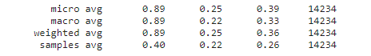
Model & Approach Contd..
Observed Performance
Group 6| Text Classification using Deep Learning

Slide 9
BERT: pre-trained word vectors
‘nlpaueb/legal-bert-base-uncased’ is specifically trained on legal documents, so it may be particularly useful for tasks related to legal text analysis.
Develop a function “get_pretrained_wordvectors” that:
Takes in the following Parameters:
sentences (list): List of sentences to process
tokenizer (object): Tokenizer object to use for encoding the sentences
bert_model (object): BERT model to use for generating the word vectors
Returns:
token_embeddings (list): List of token embeddings for the input sentences
attention_masks (torch.Tensor): Tensor of attention masks for the input sentences
input_ids (torch.Tensor): Tensor of input IDs for the input sentences
Group 6| Text Classification using Deep Learning

Slide 10
BERT: pre-trained word vectors
Initialize empty lists for input IDs and attention masks.
Tokenize, pad/truncate, and create attention masks for each sentence in the input list, and append them to the lists.
Convert the lists to tensors.
Create a TensorDataset and DataLoader using the tensors and specified batch size and number of workers.
Initialize an empty list for token embeddings.
Iterate over the data in the DataLoader, get the mean of the last four hidden states, and append it to the token embeddings list. Return the token embeddings, attention masks, and input IDs as the final outputs.
Generate token_embeddings, masks, and input_ids for input sentences using get_pretrained_word_vectors function
Create token_embeddings_masked by multiplying token_embeddings with masks tensor and reshaping it.
Group 6| Text Classification using Deep Learning

Slide 11
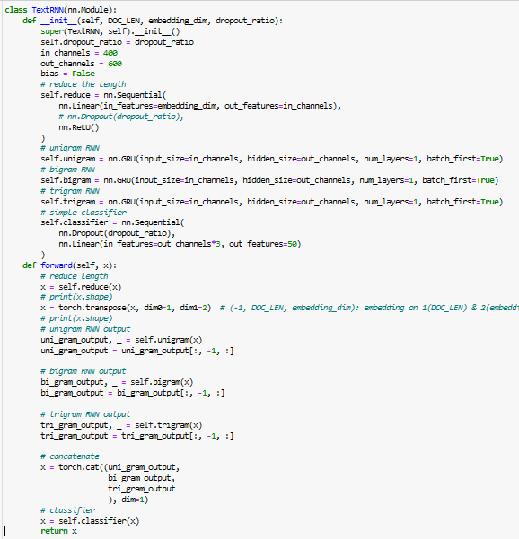
RNN for Classification:
NOTE: For classification, while we were given test data, given it was a competition, they didn’t reveal the labels for the test data, so for the project purpose, we’ve gone ahead with splitting the train and test data into an 80/20 split.
Initialize the TextRNN class with the length of the documents (DOC_LEN), the embedding dimension (embedding_dim), and a dropout ratio (dropout_ratio).
Initialize a linear layer followed by a ReLU activation to reduce the length of the input embeddings.
Initialize three GRU (gated recurrent unit) layers with a hidden size of 600 for unigram, bigram, and trigram level processing, respectively.
Initialize a dropout layer followed by a linear layer to perform classification.
In the forward pass, apply the linear and ReLU layers to the input embeddings, transpose the resulting tensor, and pass it through the GRU layers. Extract the last hidden state of each GRU layer, concatenate them, and pass them through the dropout and linear layers to obtain the final classification output. Return the final output as the result of the forward pass.

Slide 12
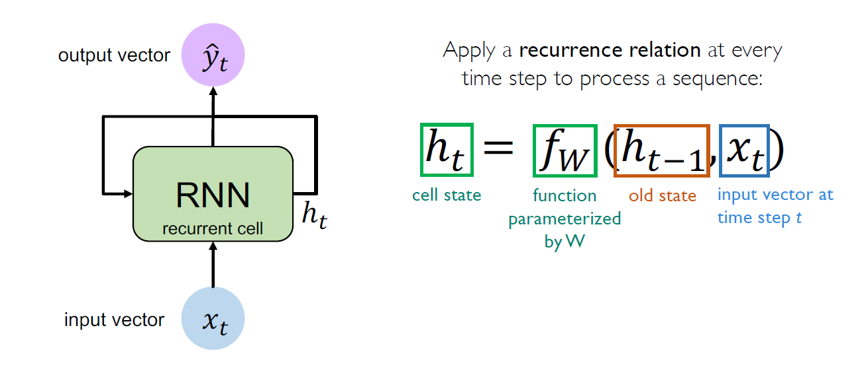
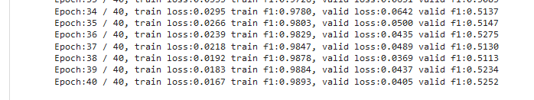
Model & Approach Contd..
Deep Learning Model 1: RNN with GRU
Sequence modeling tasks -> Given the word predicts the next Word
Input vector with Cell state of previous -> Output Vector
Use ReLU as the activation Layer for Forward Pass
Backward Pass to compute the errors and update the Weights
Fully connected Layer with Dropout with Sigmoid
Observed Performance
Test accuracy of 52.52% is observed for the validation data set
Group 6| Text Classification using Deep Learning

Slide 13
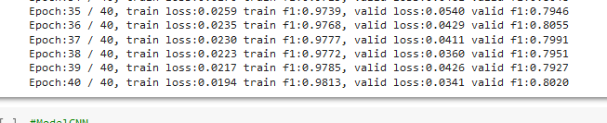
Model & Approach Contd..
Deep Learning Model 2: CNN
Map each word to Vector
Using Filter perform convolution on the Sentence Matrix -> Feature Map
Use ReLU as the activation Layer
Fully connected Layer with Dropout and sigmoid
Observed Performance
Test accuracy of 81% is observed for the validation data set
Group 6| Text Classification using Deep Learning

Slide 14
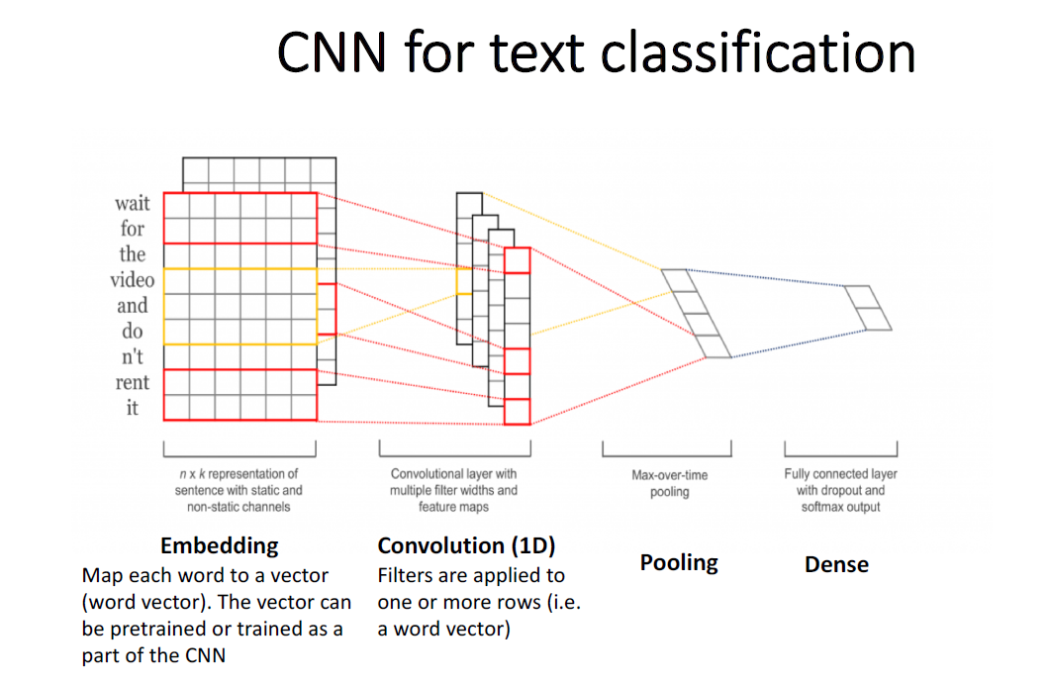
Model & Approach Contd..
Application in Text Classification Project
Convert the input Sentences to Word vector using Word Embeddings
Set Word length = 400 and used padding with 0
Used Pentagrams for feature Extraction
Performed 1Max pooling to from Concatenate Final Feature Vector
Used sigmoid activation function to Classify the Sentence.
We used Logit loss function to calculate the error
The batch size of 128 used with the epoch of 40.
Group 6| Text Classification using Deep Learning

Slide 15
Conclusion
Performance Matrix:
Future Improvements:
Sentence-transformer models to generate document-embeddings
Fine-tune base BERT models to legal compliance dataset
Use bi-directional RNNs
Model | Performance
SVM | 76%
Naïve Bayes | 33%
CNN | 81%
RNN | 52.52%
Group 6| Text Classification using Deep Learning

